Slide 1
Computer Game & Simulation Programming 2017
Felix Weingartner & Leon Weingartner

Slide 2
Game Requirements
The Game must:
Include at least 3 levels
Include at least 3 lives/chances
Keep score
Qualify for an ESRB rating of E10+

Slide 3
Development Process Plan
Generating dungeons using algorithmic code
Scene/room flow structure
Player and enemy properties
Scoring System
Bug Fixes

Slide 4
Planning Process Used to Design The Game
Ideas We wanted to implement
Randomly Generated Dungeons
Original sprites and artwork
A competitive scoring system

Slide 5
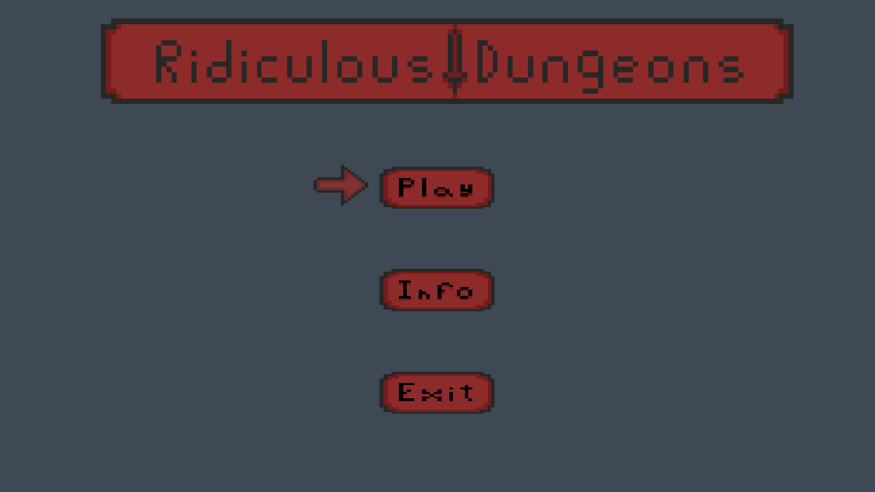
Designing
The designing phase consisted of deciding on
The color and theme
Scene flowchart
Dungeon creation mechanics
Player mechanics

Slide 6
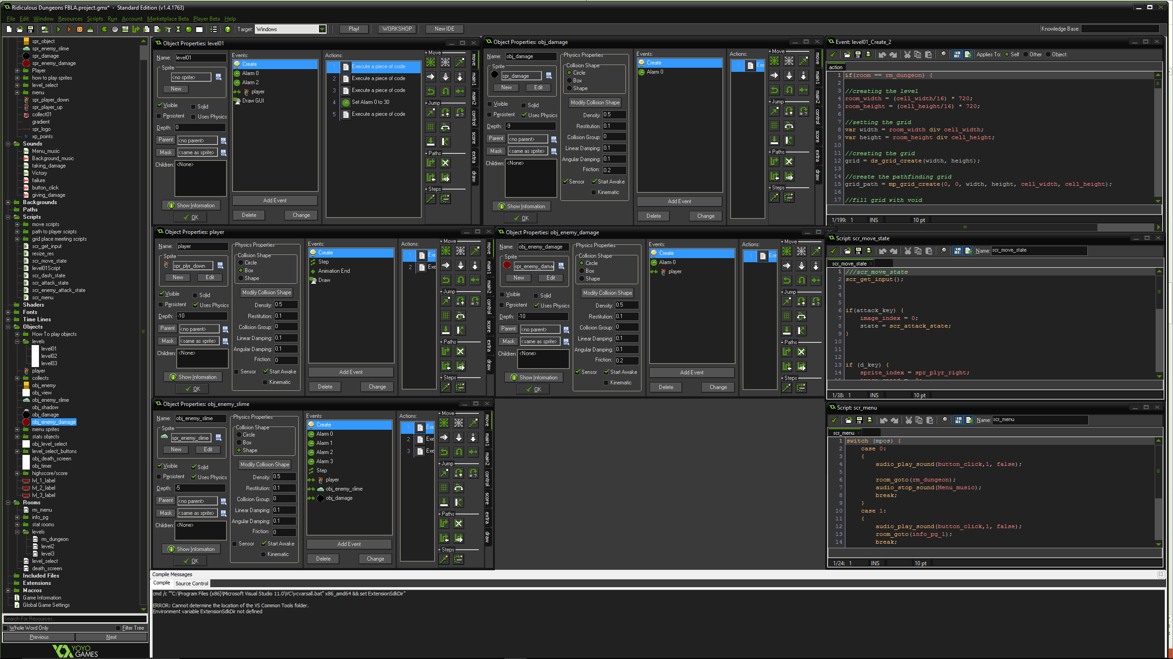
Development
The development process was predominately coding and sprite making

Slide 7


What We Used
Piskel Art Editor
Sprite making
Game Maker Studio
Game development

Slide 8
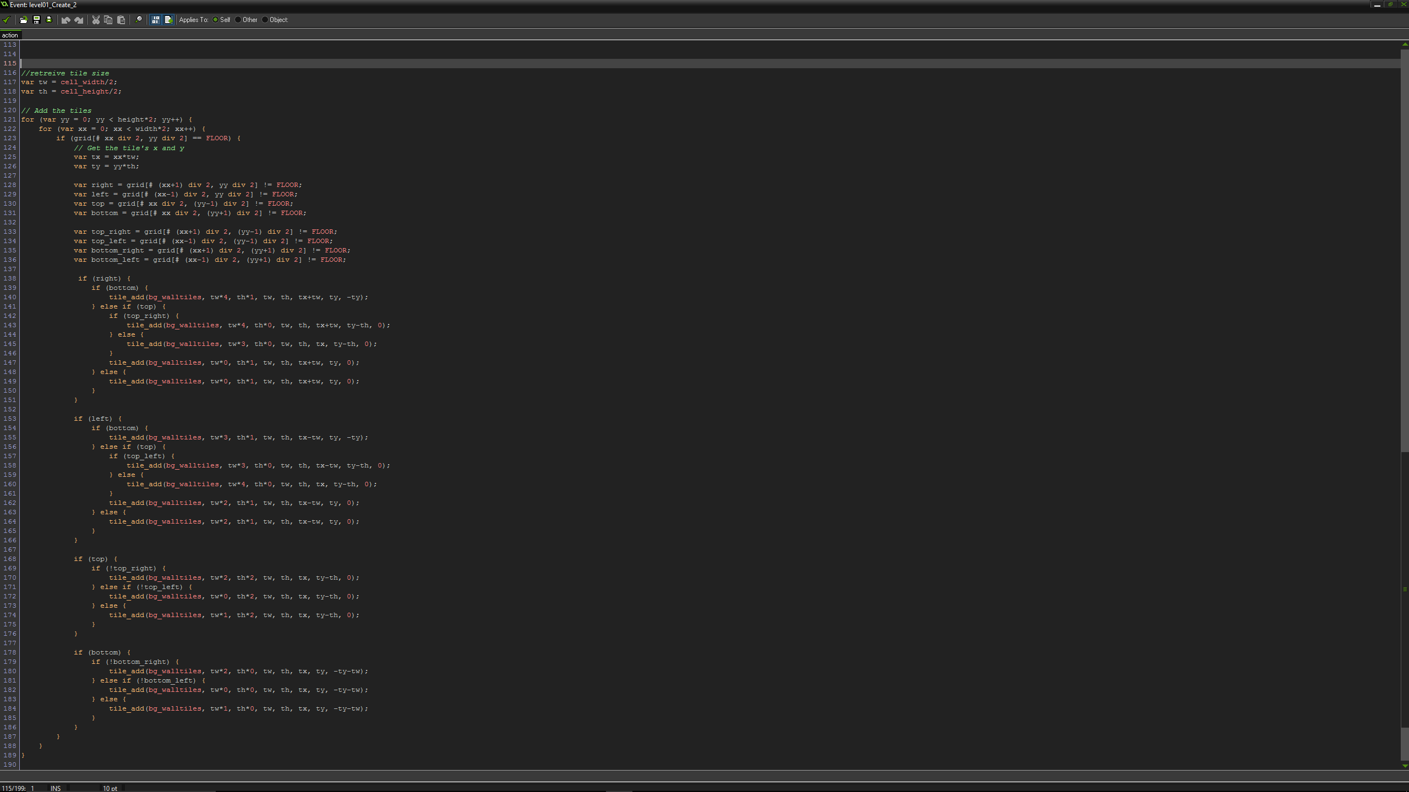
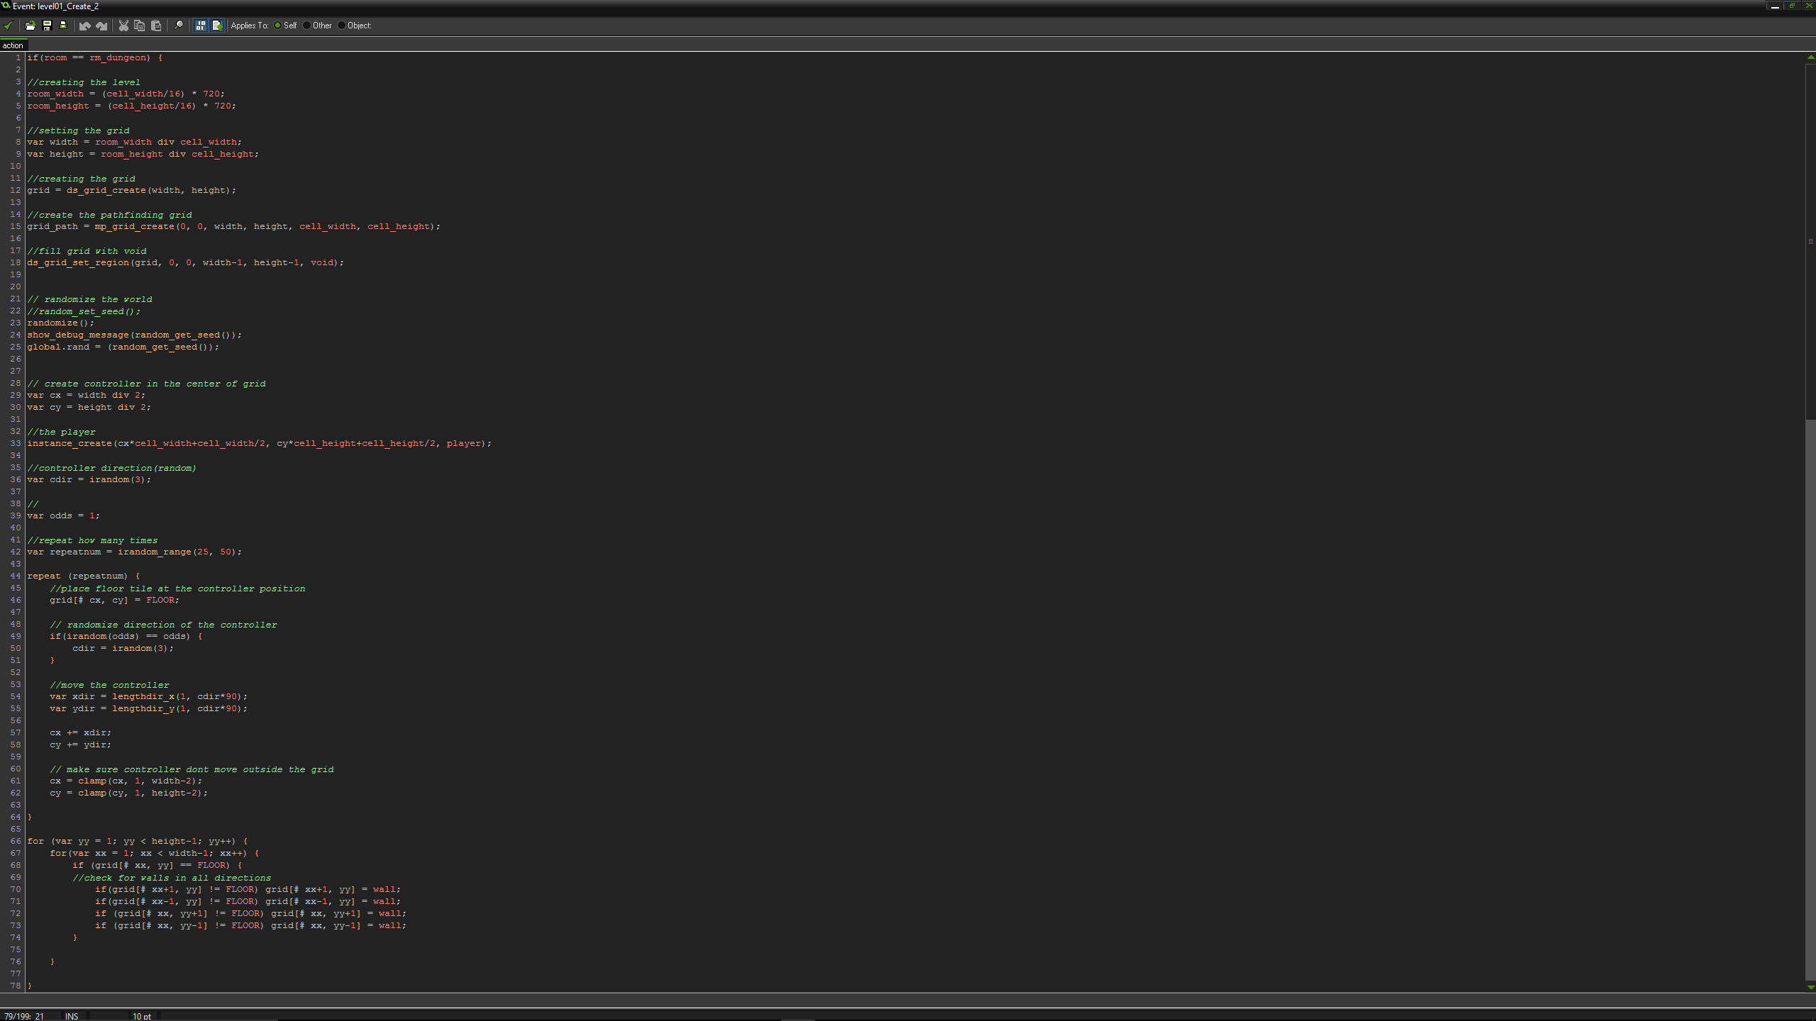

Slide 9

Problems to Fix & Debugging
We encountered several bugs and complications including
Sprites wouldn’t cycle through animation properly
The auto-tiling system didn’t work
Randomly generated dungeon goes outside of designated grid
Duplicated objects acted as one

Slide 10
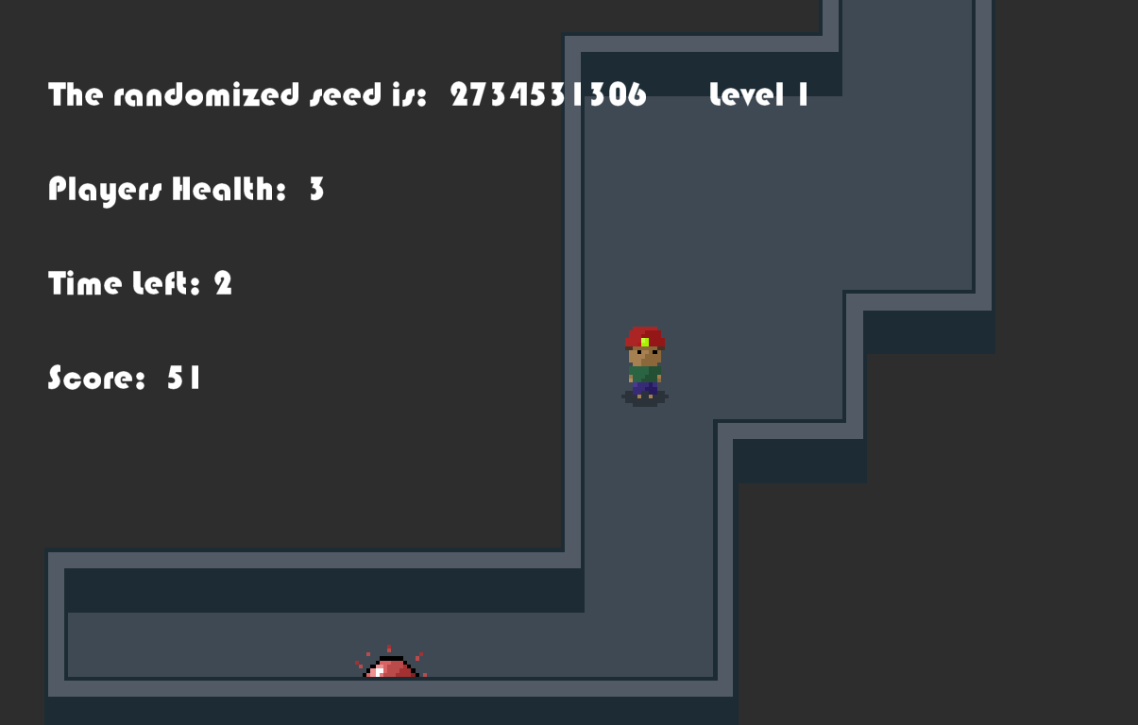
How the Game Works
Objective:
The player must
find relic within a time frame to advance
remain alive at the end of each level
Collect as many points as possible
Scoring
Players collect points based on
Time left
Players remaining health
Enemies killed

Slide 11
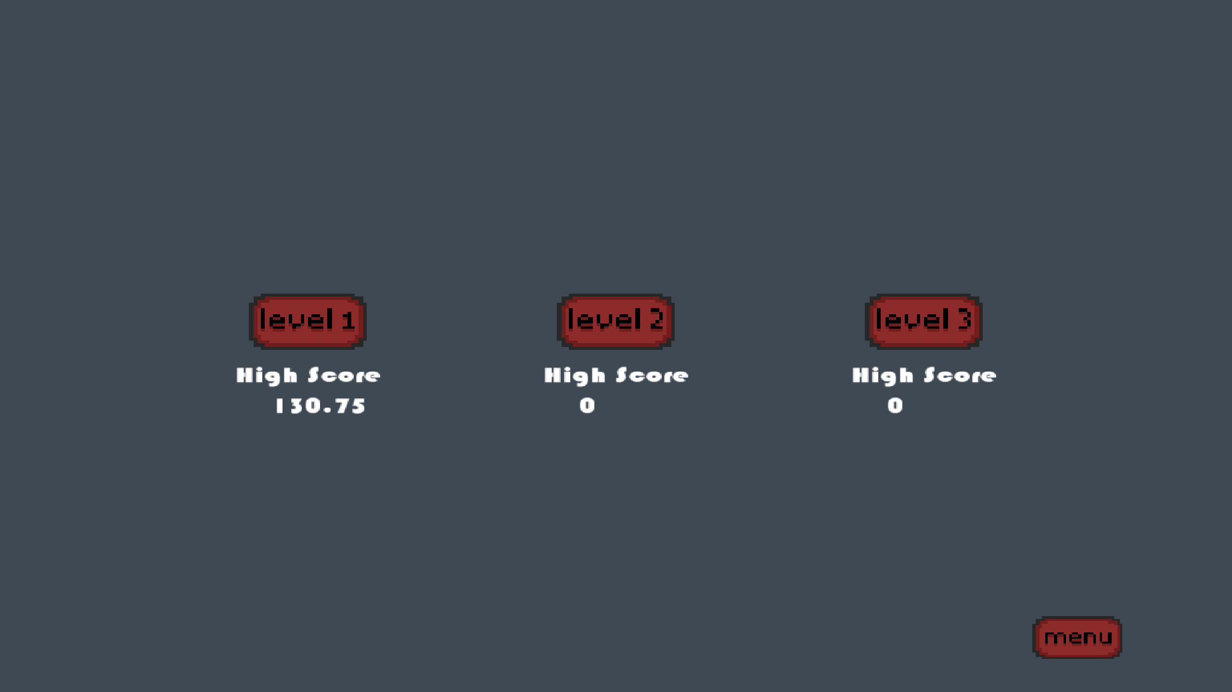
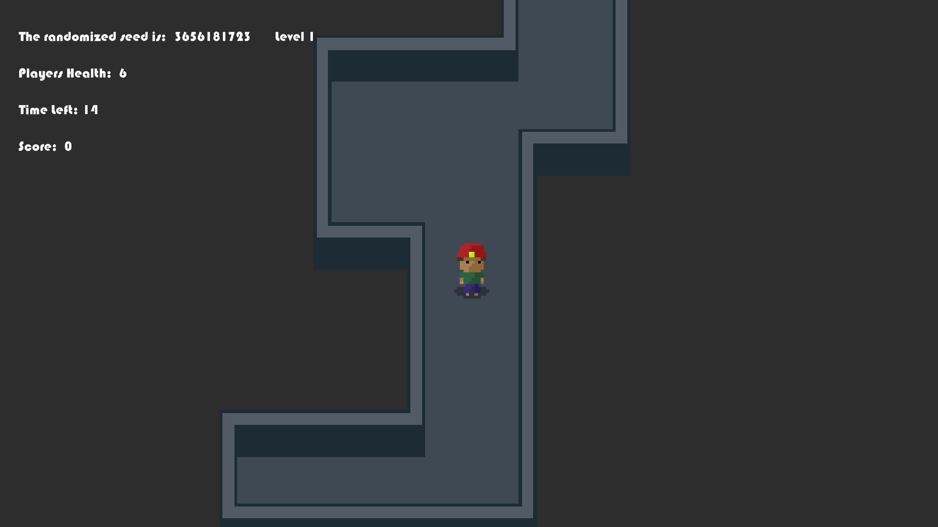
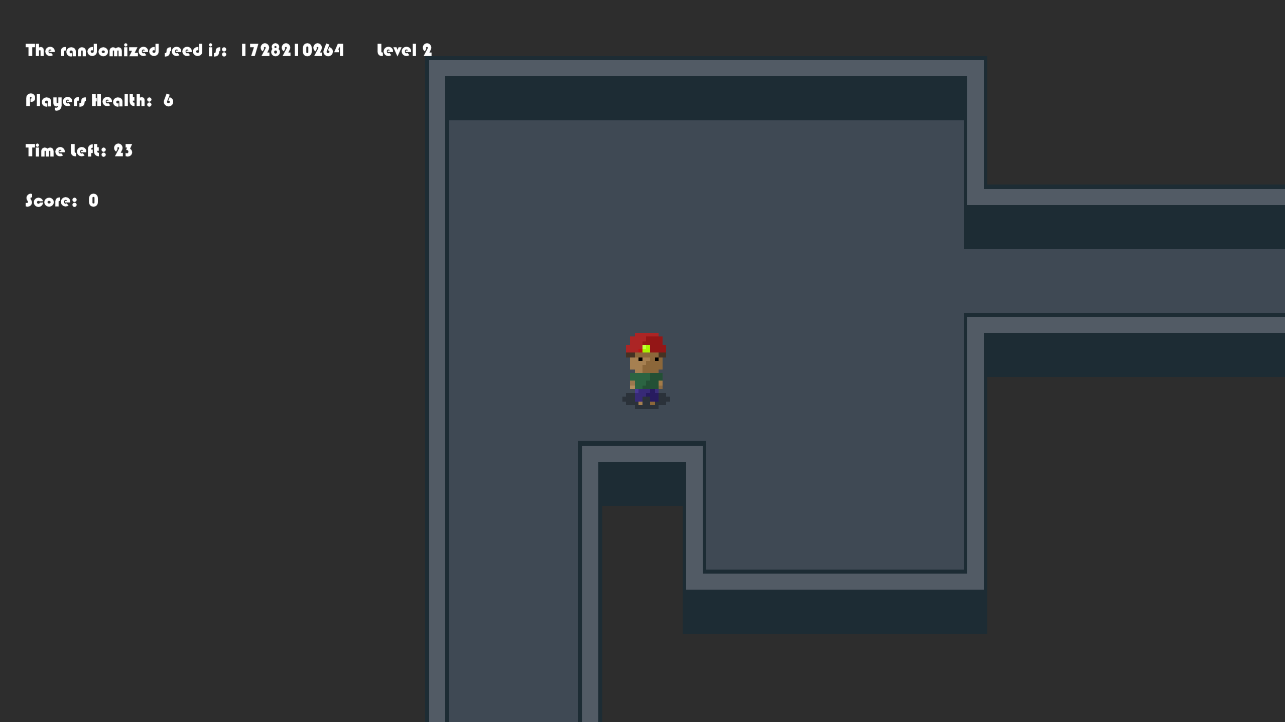
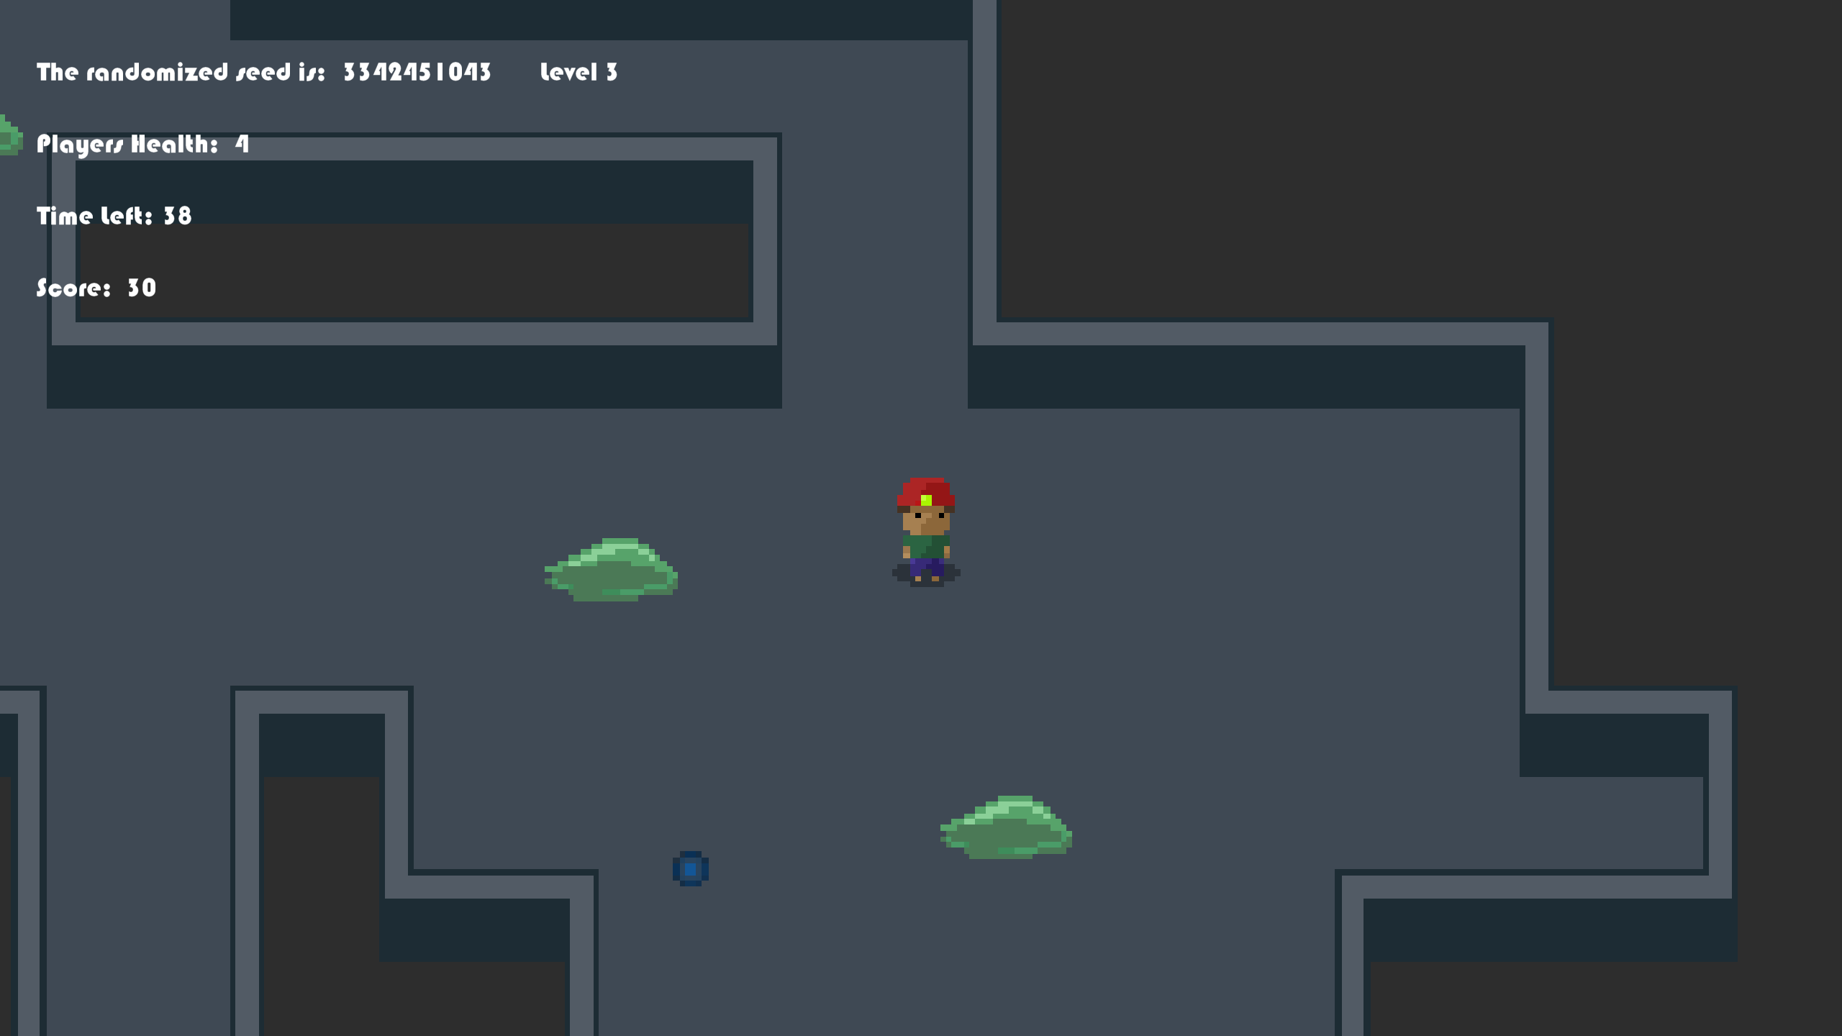
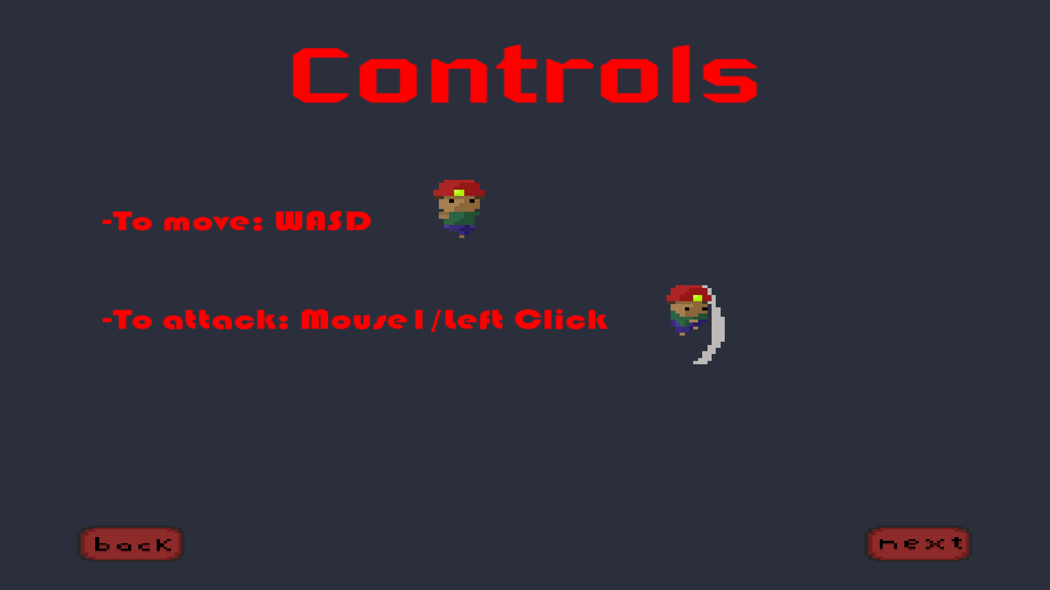
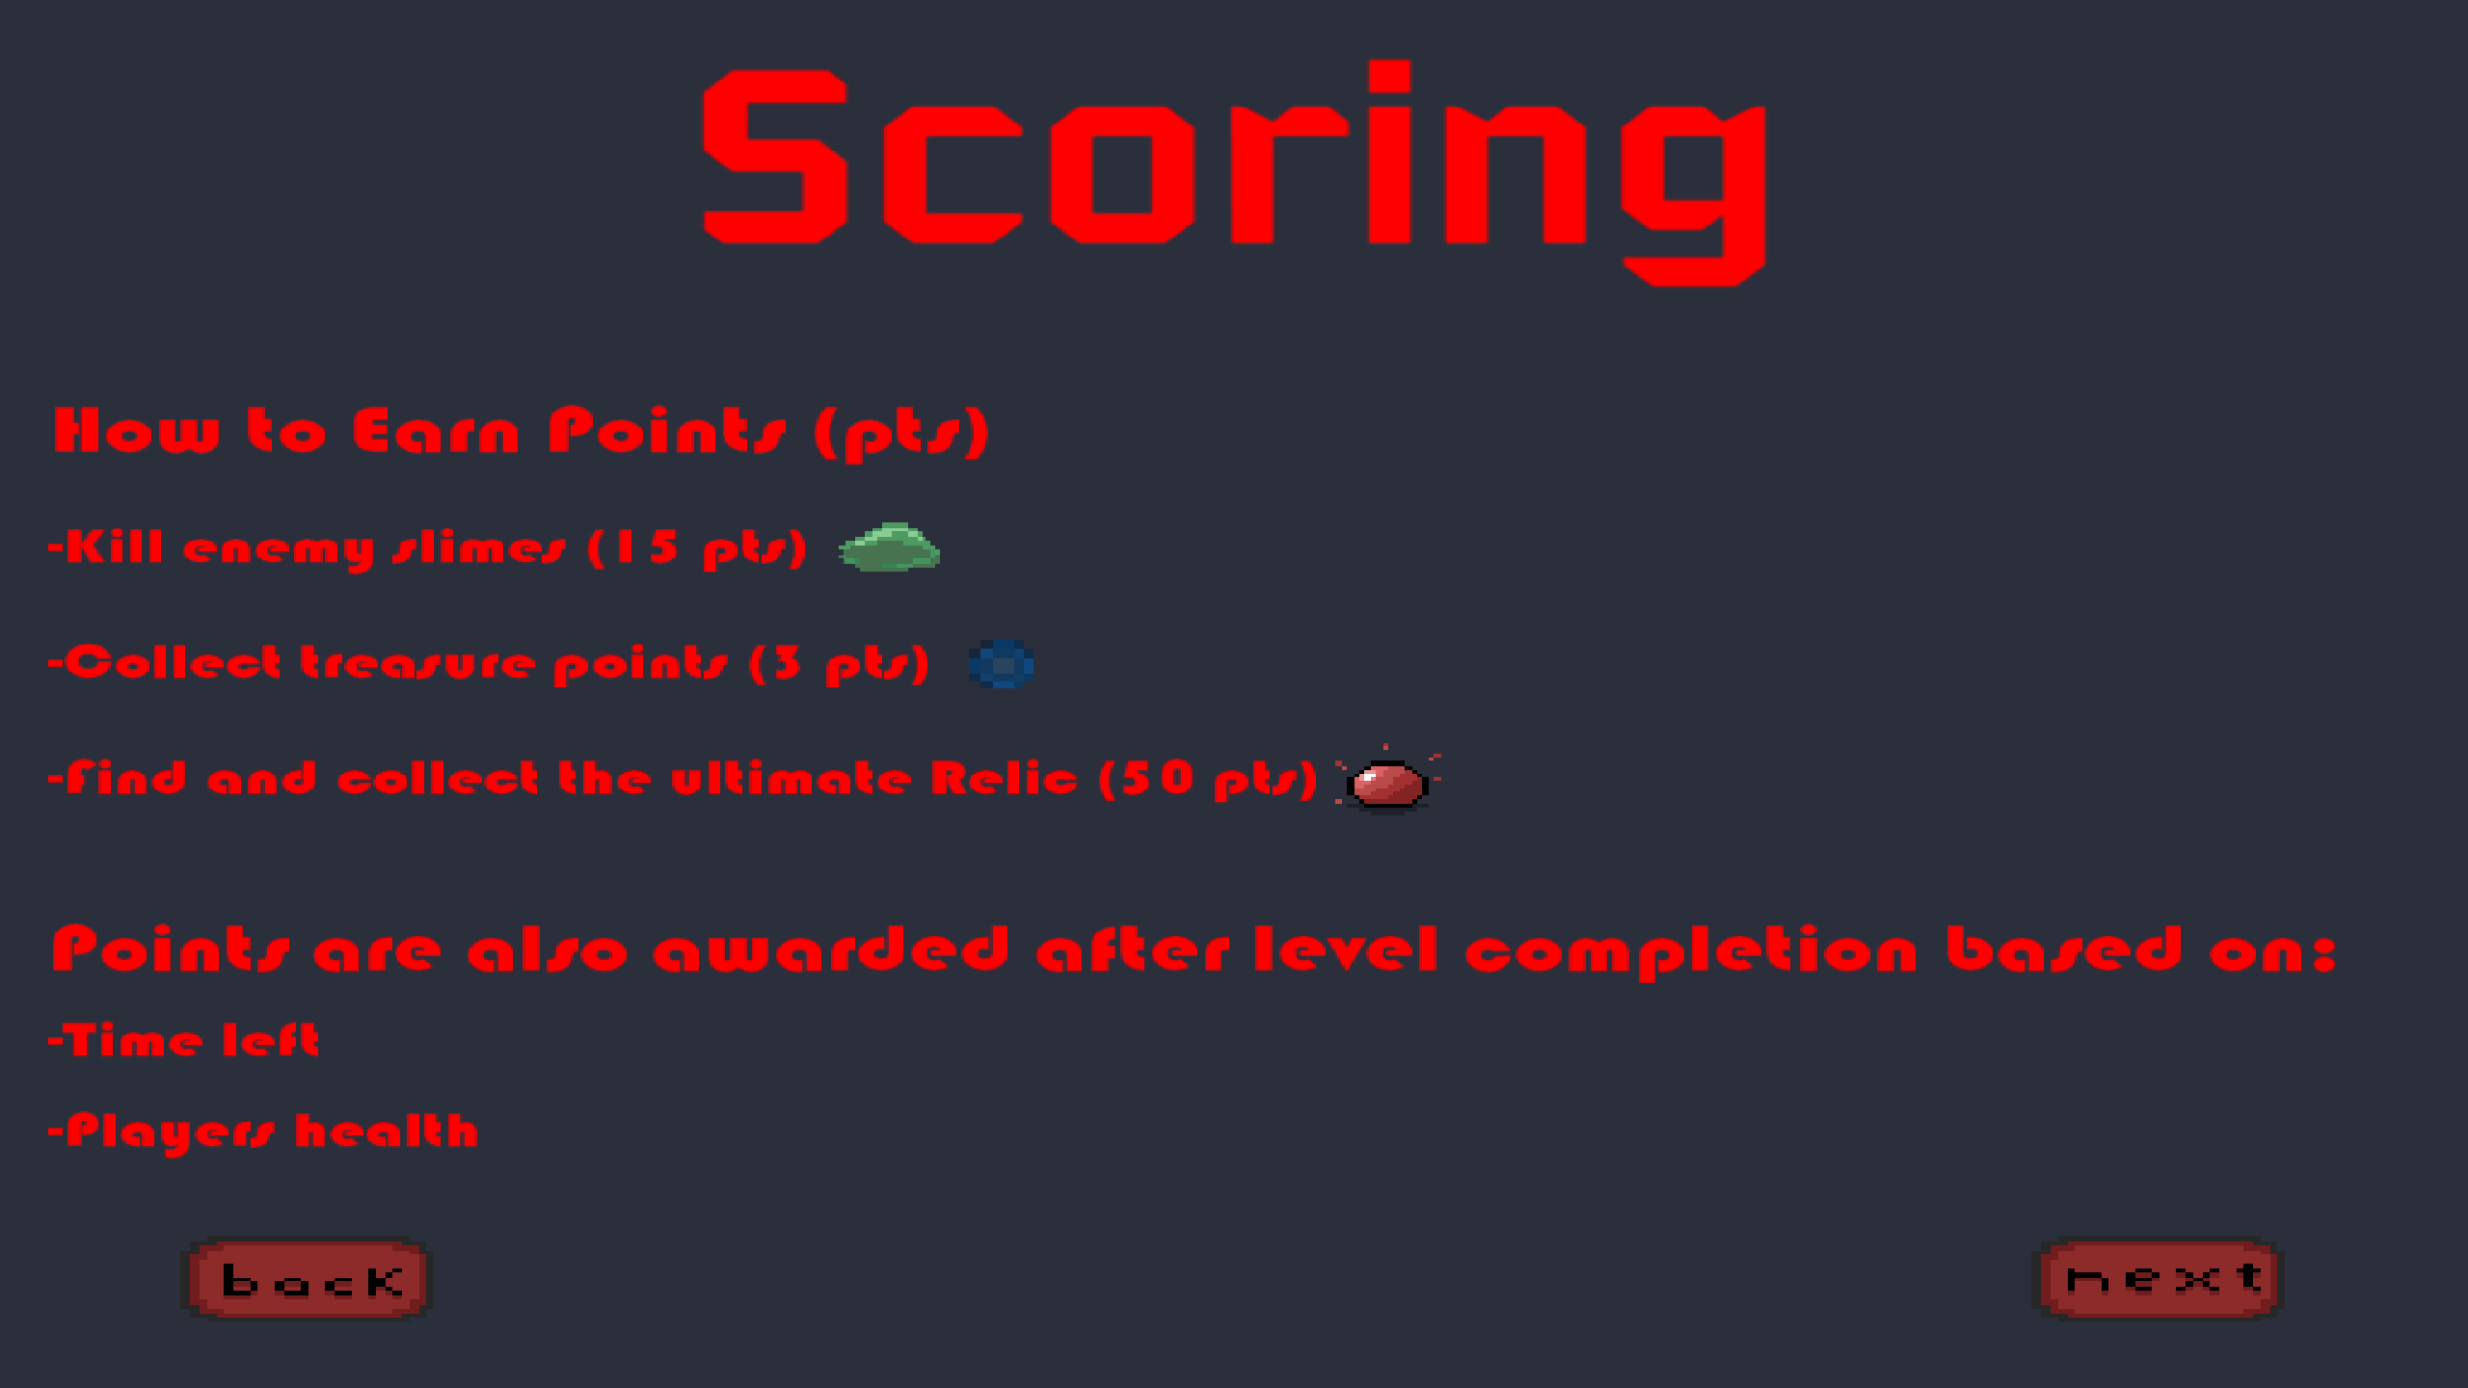
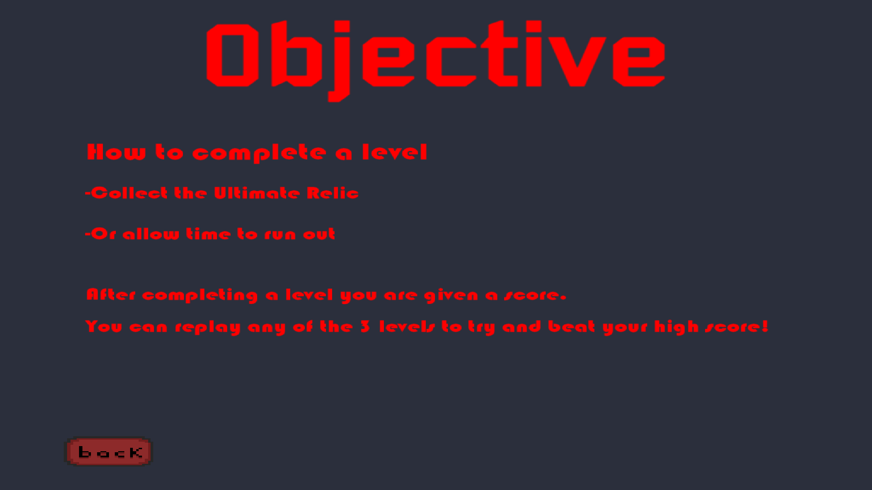
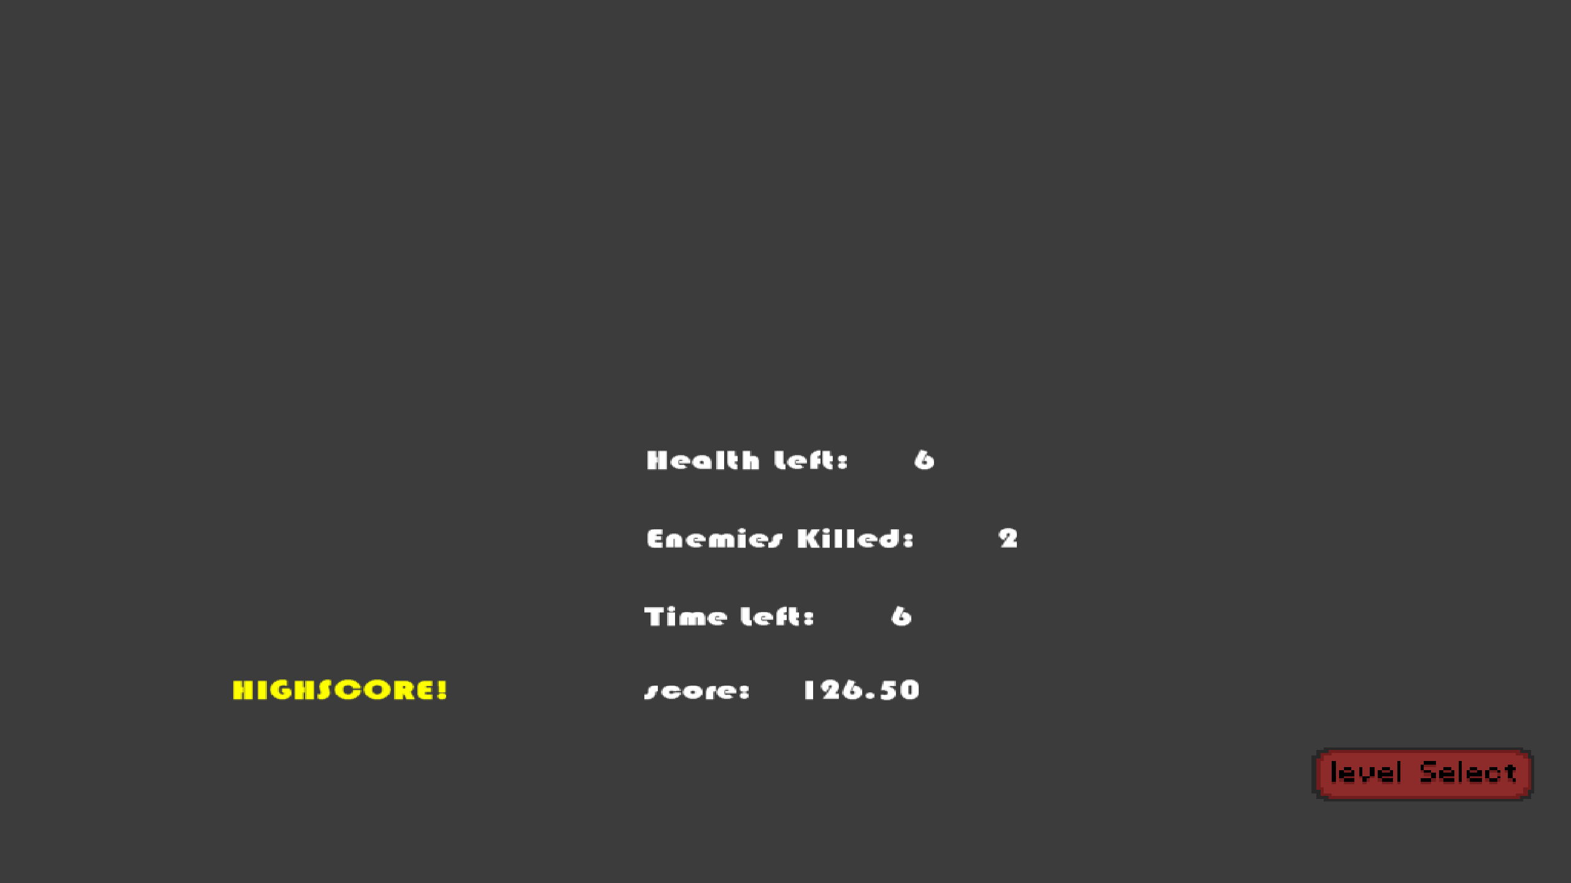
Game Flow

Slide 12
What We Learned
If We had more time
Player stats
Shop
More variety of enemies
More variety of pick-up Items
Random Generation within code
We found that using a controller along a grid to create randomized patterns was most logical alternatively to other methods
Sprite Animations
Rather than connecting individual sprites together, We applied a sprite strip making the animation process immensely easier
Document more
Although We had some, We could’ve used a lot more documentation in the code

